Slide 1

DEPARTMENT OF COMPUTER SCIENCE AND ENGINEERING
TASK MANAGEMENT SYSTEM
JAVA FULLSTACK PROJECT
PROJECT STUDENT:
Vyshnavi.M (43110532)

Slide 2
AGENDA
Abstract or Overview
Problem Statement
Objectives
System Architecture
Tech Stack
Features & Modules
Implementation(Backend+Frontend)
Results/ Screenshots
Conclusion

Slide 3
ABSTRACT
A task management system is a structured approach or software that oversees the entire lifecycle of tasks from planning to execution, testing, tracking, and reporting. It helps individuals and teams organize, prioritize, assign responsibilities, set deadlines, and monitor progress to ensure timely completion of work. By facilitating communication, collaboration, and transparency, task management systems improve productivity and accountability within groups. They serve as the foundation for efficient workflow and resource management, enabling users to manage complex projects effectively and meet collective goals with reduced manual intervention and enhanced coordination. This automation and structured management optimize task handling and contribute to the smooth functioning of organizations and teams.

Slide 4
Problem Statement
In many organizations, managing multiple projects and their associated tasks becomes increasingly complex without a proper management system. Traditional methods such as spreadsheets, emails, or manual tracking often lead to confusion, data duplication, and loss of important information. The absence of a centralized platform makes it difficult for users to efficiently create, update, and monitor projects and their respective tasks. This results in poor time management, missed deadlines, and lack of coordination among team members.
Moreover, most existing project management tools are either overly complicated or come with costly subscriptions, making them unsuitable for small teams or academic use. Therefore, there is a need for a lightweight, user-friendly, and reliable system that simplifies project and task management. The application should provide complete CRUD (Create, Read, Update, Delete) functionality, real-time updates, and proper input validation to ensure data accuracy

Slide 5
OBJECTIVES
To design and develop a full-stack web application for managing projects and tasks
To implement CRUD operations for both Projects and Tasks.
To ensure real-time updates and responsiveness in the user interface
To maintain a scalable and modular architecture.
To follow clean coding practices, proper validation, and testing.

Slide 6
System Architecture
Architecture Overview:
Frontend (React.js): Provides a responsive UI for managing projects and tasks.
Backend (Spring Boot): Exposes RESTful APIs for CRUD operations.
Database (PostgreSQL): Stores all data persistently.
Flyway: Handles database migrations.
Axios: Enables communication between frontend and backend.

Slide 7
TECH STACK
Layer | Technologies
Frontend | React.js, Axios, React Router
Backend | Java 21, Spring Boot 3, Hibernate, JPA
Database | PostgreSQL
Migrations | Flyway
Build Tools | Maven, npm/yarn
Testing | JUnit 5, Mockito

Slide 8
FEATURES
CRUD operations for Projects and Tasks
Separate pages for Projects and Tasks using React Router
Real-time UI updates
Modal confirmation before deletion
Input validation and error handling
Swagger-based API documentation
Responsive design for desktop and mobile

Slide 9
Backend Implementation
Developed using Spring Boot framework.
RESTful APIs created for project and task management.
Utilized Spring Data JPA for database interaction.
Database schema managed with Flyway migrations.
Unit testing done using JUnit 5 and Mockito.
Example API endpoints:
GET /projects/all
POST /tasks/add
DELETE /projects/delete/{id}

Slide 10
Frontend Implementation
Developed using React.js with hooks.
Integrated Axios for API communication.
Managed navigation using React Router.
Used state management for real-time UI updates.
Modal components used for edit/delete confirmations.
Responsive layout built with modern CSS.

Slide 11
CONCLUSION
In conclusion, a task management system is an essential tool that streamlines the planning, organization, assignment, and tracking of tasks within projects or teams. By providing features such as task creation, assignment, prioritization, progress tracking, collaboration tools, and notifications, it enhances productivity, accountability, and communication. The system’s design and architecture support scalability, security, and real-time updates, enabling teams to manage workflows efficiently. As task management systems continue to evolve, integrating intelligent automation, improved analytics, and adaptive workflows will further enhance their ability to meet dynamic project demands. Implementing an effective task management system contributes significantly to achieving project goals, optimizing resources, and fostering seamless teamwork in any organizational setting.

Slide 12
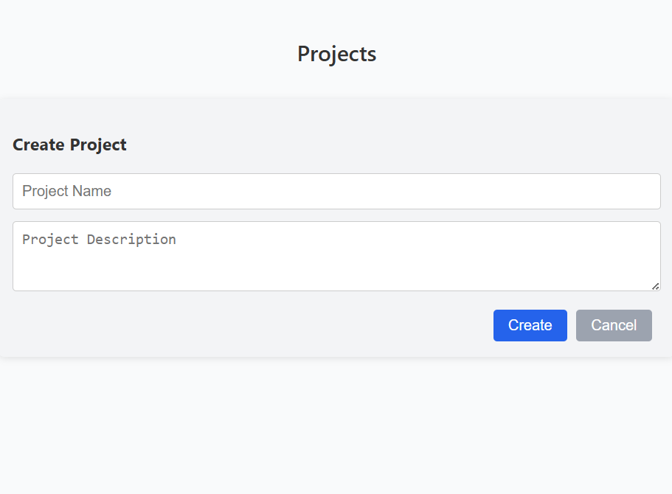
RESULTS

Slide 13
THANK YOU
We thank God, Our Department, Guide, Panel Members, Supportive Professors and all Technical and non Technical staff who helped us in our Project.

